Slide 1

DEPARTMENT OF COMPUTER SCIENCE & ENGINEERING
SCHOOL OF COMPUTING
1156CS701- MAJOR PROJECT
INTERNSHIP THROUGH DIND
WINTER SEMESTER(22-23)
SEMESTER END PROJECT VIVA VOCE EXAMINATIONS
“TOPIC-LEVERAGING TO PREDICT FOREST FIRES USING MACHINE LEARNING”
SUPERVISED BY
Ms.R.VAISHANAVI M.E
Assistant professor
PRESENTED BY
1. Goli Pavan (VTU14400)(19UECS0313)
2. V.C Jagapathi Babu (VTU13952)(19UECS1107)
3. G Krishna Chaitanya (VTU12658)(19UECS0281)

Slide 2
INDUSTRY DETAILS
Industry Name/Institute Name: Boston IT solutions india pvt limited
Duration of Internship (From Date – To Date):( Feb 18-May 20)
Duration of Internship in Months:3Months
Industry Guide Name: Rethishwar
Industry Guide Mobile No : 6369358668
Industry Guide Mail ID: rethishvaar.selvakumar@bostonindia.in
Industry Address: Bangalore
Project Completion Status as of now(Completed/In-Progress):InProgress

Slide 3
AGENDA
ABSTRACT
OBJECTIVE
INTRODUCTION
LITERATURE REVIEW (SOFT COPY OF PAPERS TO BE LINKED AS HYPERLINK)
DESIGN AND METHODOLOGIES
IMPLEMENTATION
TESTING
INPUT AND OUTPUT
INCLUDE DEMO VIDEO-1 (Till REVEW-1)
INCLUDE DEMO VIDEO-2(Complete Implementation of Project)
CONCLUSION
WEB REFERENCES LINK(TILL REVIEW DATE ALL LINKS TO BE INCLUDED DAY WISE)
INCLUDE YOUR 2 PHOTOS OF YOUR INDUSTRY WORKING ENVIRONMENT
PLAGIARISM REPORT OF PPT
REFERENCES

Slide 4
ABSTRACT
Forest Fire Prediction is a key component of forest fire control. This is a major environmental problem that creates ecological destruction in the form of a threatened landscape of natural resources that disrupts the stability of the ecosystem, increases the risk for other natural hazards, and decreases resources such as water that causes global warming and water pollution. Fire Detection is a key element for controlling such incidents. Prediction of forest fire is expected to reduce the impact of forest fire in the future. Many fire detection algorithms are available with different approach towards the detection of fire. In the existing work processes the fire affected region is predicted based on the satellite images. To predict the occurrences of a forest fire the proposed system processes using the meteorological parameters such as temperature, rain, wind and humidity were used. Random forest regression and Hyperparameter tuning using Random Forest algorithm that combines multiple decision trees to make a more accurate prediction. In the case of forest fire prediction, the algorithm can take in various environmental and meteorological data such as temperature, humidity, wind speed, precipitation, and other variables that may affect forest fire risk.

Slide 5
OBJECTIVES
Aim of the project :
The Aim of the Project is to develop a reliable and accurate algorithm that can predict the likelihood and severity of forest fires in a given area based on relevant environmental factors, such as temperature, humidity, wind speed, and vegetation cover. By providing early warning of potential forest fires, this algorithm could help reduce the damage caused by wildfires and improve response times for emergency services, thereby enhancing public safety and protecting valuable natural resources.
Scope of the project :
This study uses machine learning techniques to forecast forest fires . For more accuracy, this project employs a random forest regressor. Training and test data will be separated from the forest fire exploration dataset. The model for supervised learning receives input from the training data.

Slide 6
INTRODUCTION
Forest fires (also known as wildfires) are one of the recent calamities that occur most often. Several acres of forest are being burned as a result of these flames. The primary causes of forest fires are global warming because of the a rise in the earth's average temperature and carelessness on the part of people. Forest fires are brought on by human activities like animal husbandry and agriculture in Africa ,india . The spread of flames may now be predicted using a variety of technologies, including mathematical and physical models. In order to specify and forecast fire development in various places, these models rely on data collecting during forest fires, modelling, and lab experimentation.The spread of flames may now be predicted using a variety of technologies, including mathematical and physical models. For the purpose of describing and forecasting fire growth in several places, these models rely on data gathered during forest fires, modelling, and lab trials. In recent years, simulation tools have been employed to forecast forest fires, however these systems have encountered issues with data quality and tool execution time. A form of artificial intelligence called machine learning

Slide 7
LITERATURE REVIEW
Javed, S., Hussain, M., Riaz, S., & Abbas, Q. (2020). Forest Fire Prediction Using Machine Learning and Internet of Things.
This paper proposes a forest fire prediction system using machine learning and internet of things (IoT) technologies. The system collects real-time environmental data using IoT sensors and feeds it into machine learning algorithms for prediction. The authors demonstrate the effectiveness of their approach through experimental results.

Slide 8
LITERATURE REVIEW
Gao, X., Wei, Y., & Zhao, Y. (2020). "Forest fire detection based on deep learning and multiple features“.
In this paper, the authors propose a forest fire detection system based on deep learning and multiple features. The system uses convolutional neural networks (CNN) to extract features from images and then employs support vector machines (SVM) to classify the images. The results show that the proposed system outperforms other methods in terms of accuracy and efficiency.

Slide 9
LITERATURE REVIEW
Karimi, B., & Ghaemi, A. (2020). "Prediction of forest fires using machine learning algorithms".
This paper presents a study on the prediction of forest fires using machine learning algorithms. The authors use meteorological variables, such as temperature, humidity, wind speed, and rainfall, to train different machine learning models, including decision tree, random forest, and support vector machines. The results indicate that the random forest model outperforms other models in terms of prediction accuracy.

Slide 10
LITERATURE REVIEW
Neri, A., & Angelini, M. G. (2019). Fire risk forecasting using machine learning models based on meteorological data
In this paper, the authors propose a fire risk forecasting model based on machine learning algorithms and meteorological data. They apply their model to different forest areas in Italy and find it to be effective in predicting the risk of forest fires.

Slide 11
DESIGN AND METHODOLOGIES
MODULE 1 : Data Collection and Pre processing
MODULE 2 : Feature Selection
MODULE 3 : Model Development
MODULE 4 : Model Deployment
MODULE 5 : Model Monitoring and Maintenance

Slide 12
MODULE 1
Step 1: Gather information on historical forest fires, including their locations and any variables that may have influenced their occurrence (such as weather, human activity, etc.)
Step 2: Cleanse the data, examine it for outliers or missing numbers, and then convert it into a format that machine learning algorithms can utilise.

Slide 13
MODULE 2
Step 1: Do a data analysis to pinpoint the key elements that are most likely to have an impact on the occurrence of forest fires.
Step 2: Choose a portion of these features to include in the model, being careful to avoid having them substantially associated with one another.

Slide 14
MODULE 3
Step 1: Separate the data into training and testing sets.
Step 2: Use the training data to train the random forest algorithm.
Step 3: Assess the model's performance on the testing set and adjust the algorithm's parameters as necessary.

Slide 15
MODULE 4
Step 1: To create predictions on new data, use the trained random forest algorithm.
Step 2: Install the model in a user-friendly interface (e.g., a web app) so that users may enter information about their location and other relevant factors and obtain a prediction about their probability of being affected by a forest fire.

Slide 16
MODULE 5
Step 1: Monitor the model's performance over time to ensure that it continues to make correct predictions.
Step 2: Retrain the model on new data on a regular basis and tweak the feature selection and model parameters as needed to increase accuracy.

Slide 17
STANDARDS AND POLICIES
IEEE 829 - Software Test Documentation.
IEEE 830 - Software Requirements Specifications.
IEEE 1012 - Software verification and validation.
IEEE 1016 - Software design description.

Slide 18
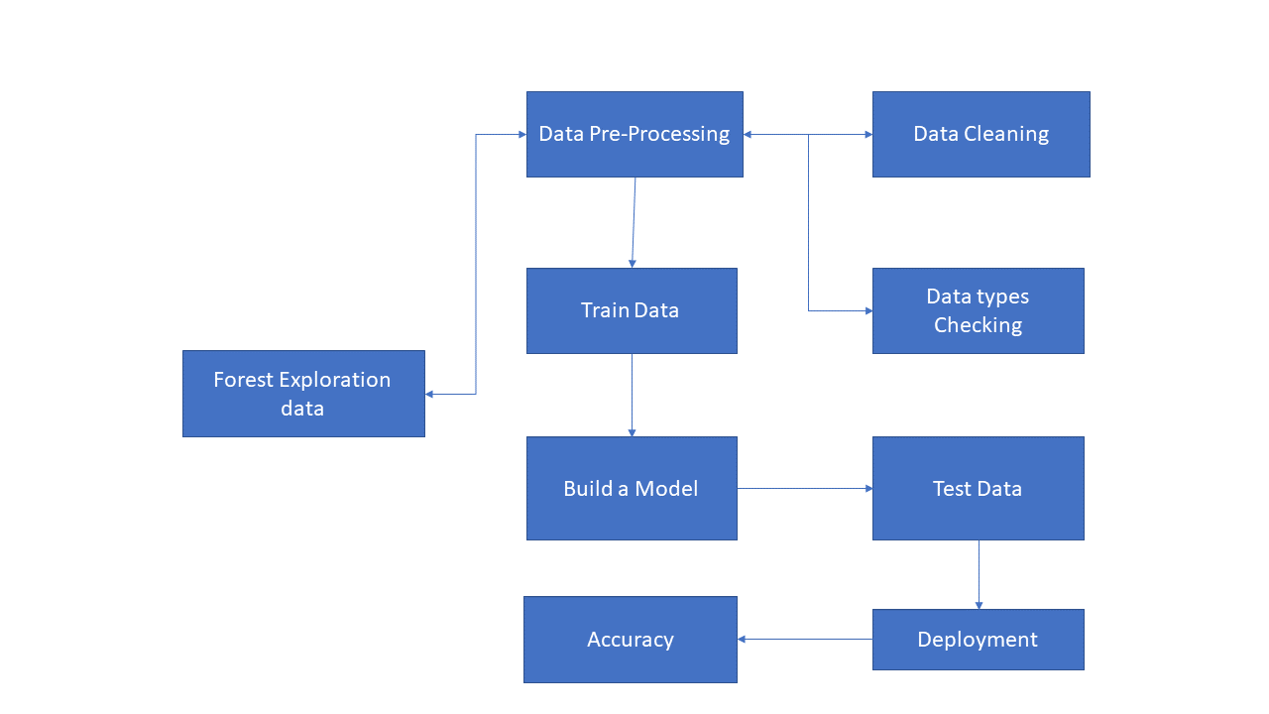
IMPLEMENTATION
ARCHITECTURE DIAGRAM

Slide 19
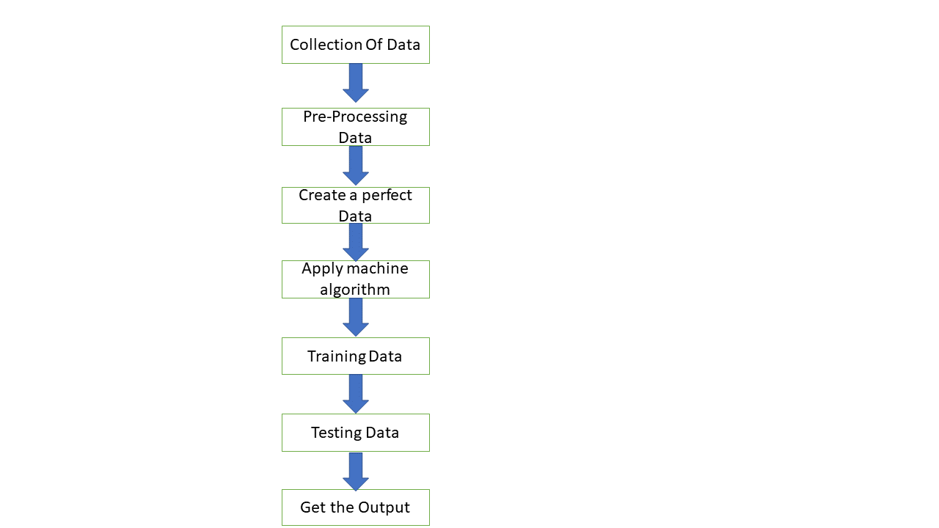
IMPLEMENTATION
DATA FLOW DIAGRAM

Slide 20
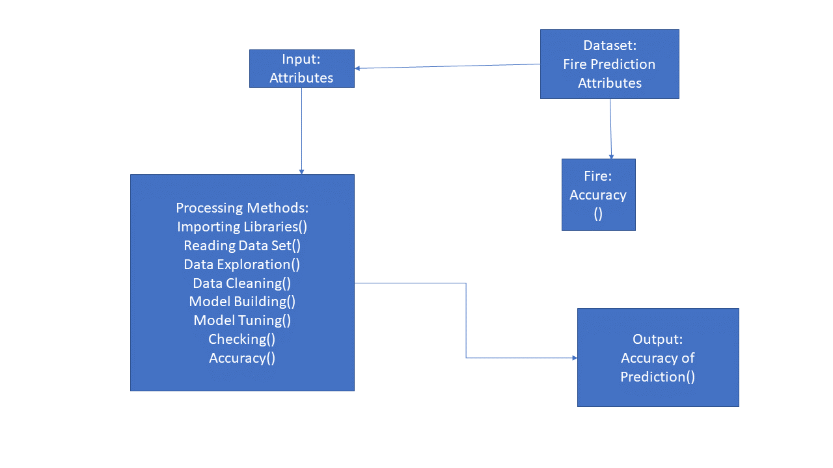
IMPLEMENTATION
CLASS DIAGRAM

Slide 21
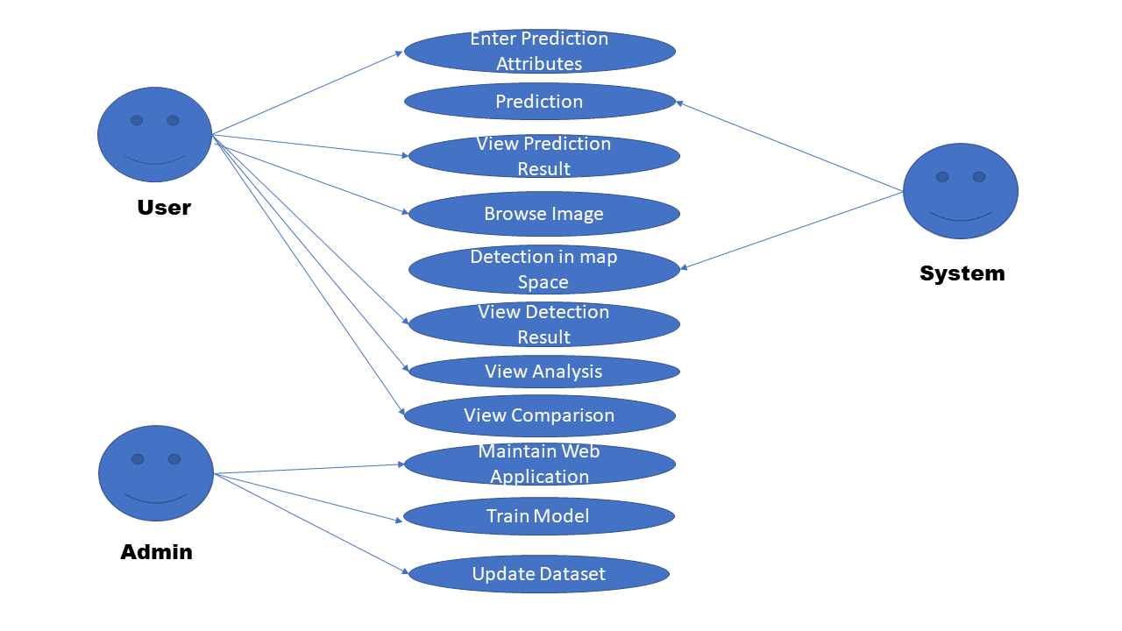
IMPLEMENTATION
USER CASE DIAGRAM

Slide 22
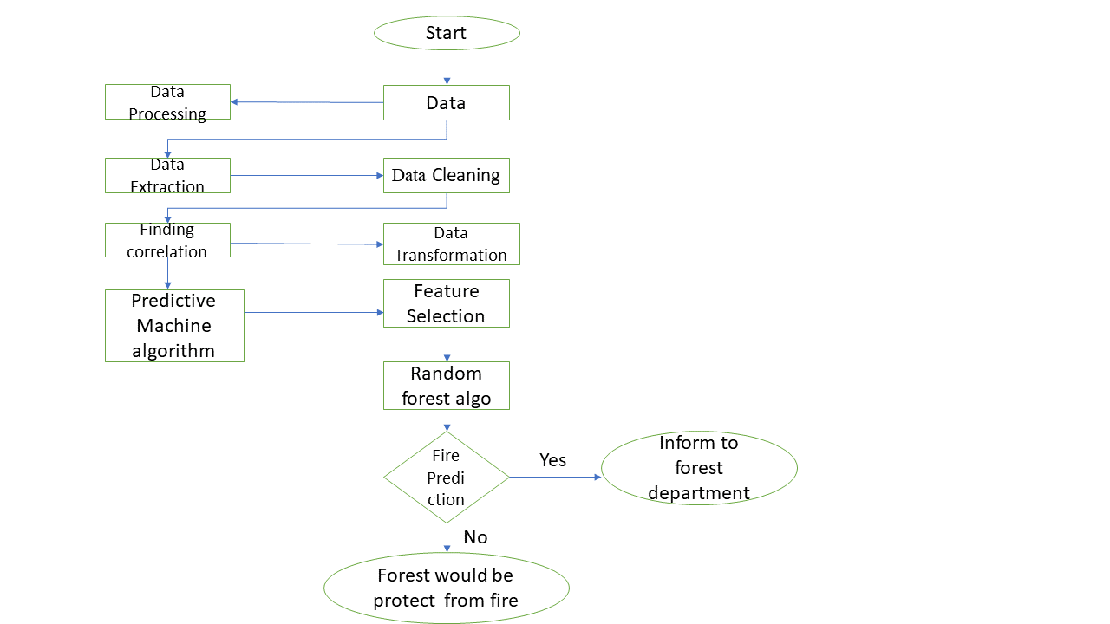
IMPLEMENTATION
ACTIVITY DIAGRAM

Slide 23
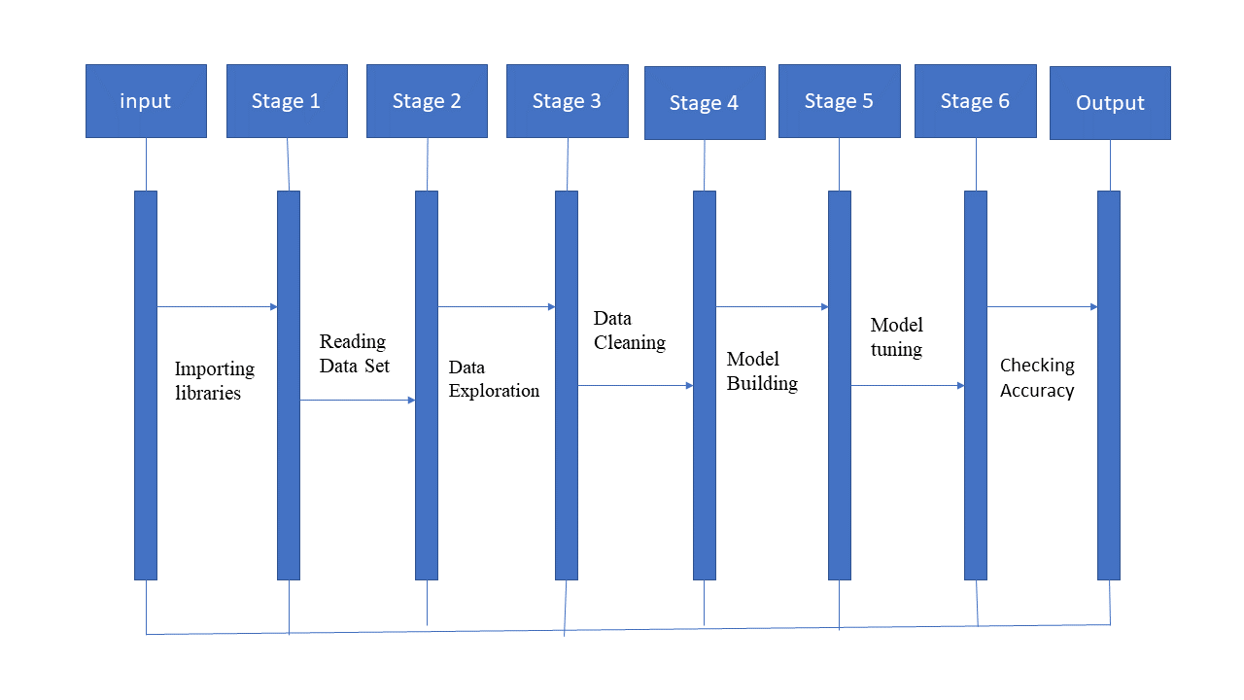
IMPLEMENTATION
SEQUENCE DIAGRAM

Slide 24
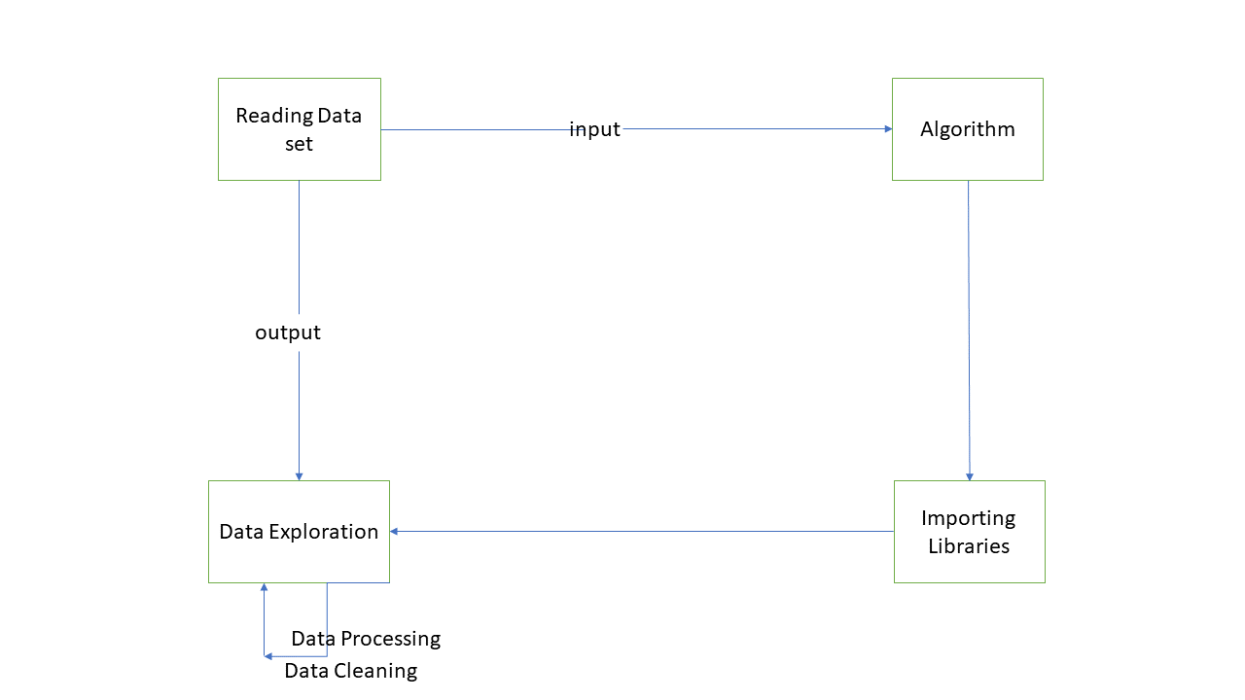
IMPLEMENTATION
COLLABORATION DIAGRAM

Slide 25
TESTING
UNIT TESTING
INTEGRATION TESTING
FUNCTIONAL TESTING
WHITE BOX TESTING
BLACK BOX TESTING

Slide 26
UNIT TESTING
Unit testing entails putting individual pieces of code to the test to make sure they all function as they should. For this project, we may unit test the methods and functions needed to prepare the data, build the model, and provide predictions. To make sure the functions are operating properly and producing the desired outputs, test cases may be written. We may check things like whether the input data has been correctly cleaned, if the model is being trained with the right parameters, and whether the predictions are valid.

Slide 27
INTEGRATION TESTING
Integration testing examines the relationships between the various software modules. To make sure the preprocessing, training, and prediction algorithms in this project all function properly, we may undertake integration testing. Also, we may examine how well the data is transferred across the various components. For instance, we may check to see if the model's predictions are accurate and the training data is appropriately translated and fed into it.

Slide 28
FUNCTIONAL TESTING
Functional testing involves testing if the software meets the specified functional requirements. In the case of this project, we can perform functional testing by checking if the model can predict forest fires accurately. We can also test if the application's user interface works correctly and if the data is properly displayed. For example, we can test if the model can predict forest fires with a certain level of accuracy, and if the application displays the predicted results in a clear and easy-to-understand way.

Slide 29
WHITE BOX TESTING
White box testing involves testing the internal workings of the software, including the code and its logic. In this project, we can perform white box testing by examining the source code to ensure that it follows the best practices of programming, such as proper indentation, variable naming conventions, and comments. We can also test if the code is optimized for performance.

Slide 30
BLACK BOX TESTING
Black box testing is a type of software testing in which the tester is not aware of how the system being tested operates inside. Black box testing will be carried out in this forest fire prediction project to make sure the system is operating as planned and making reliable forecasts.

Slide 31
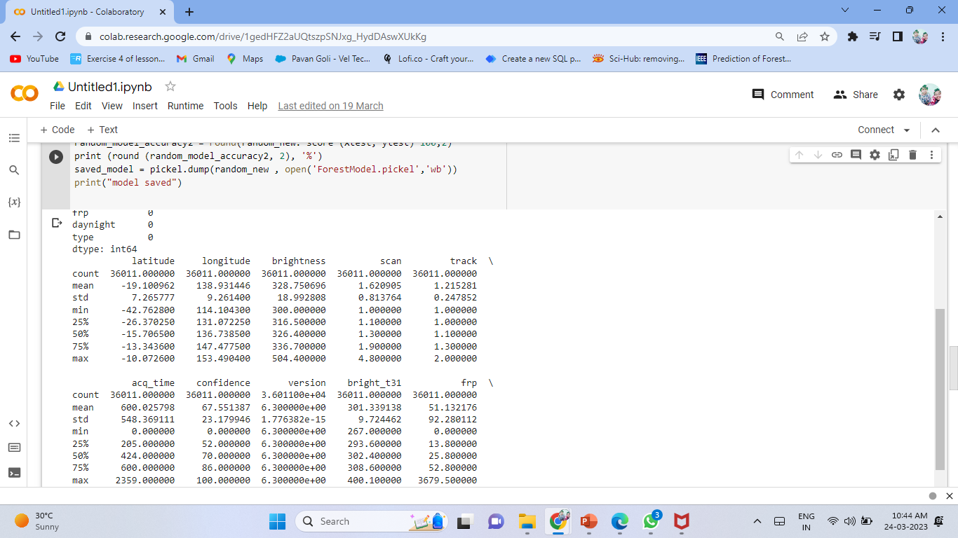
INPUT AND OUTPUT

Slide 32
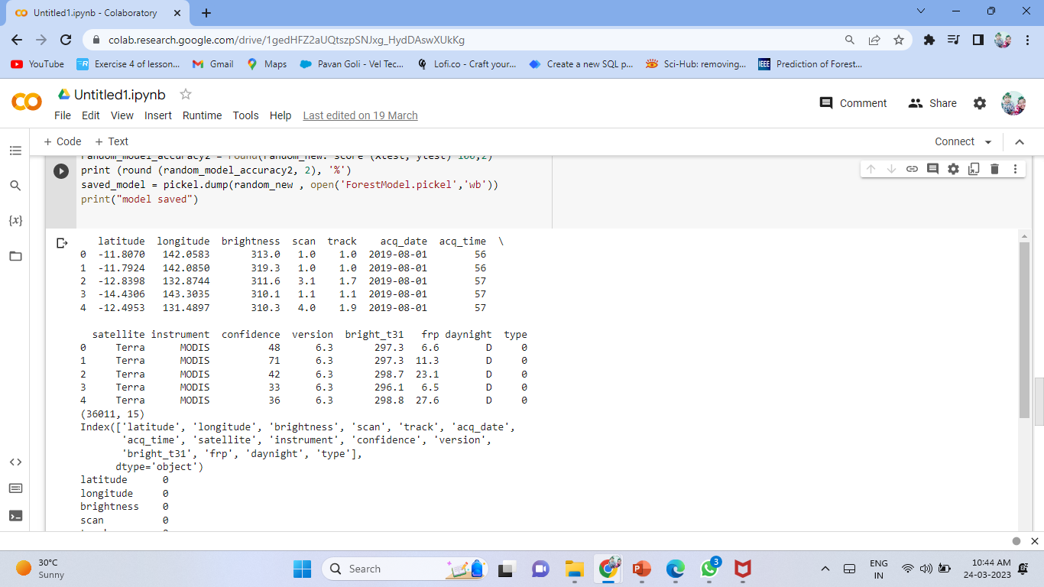
INPUT AND OUTPUT

Slide 33
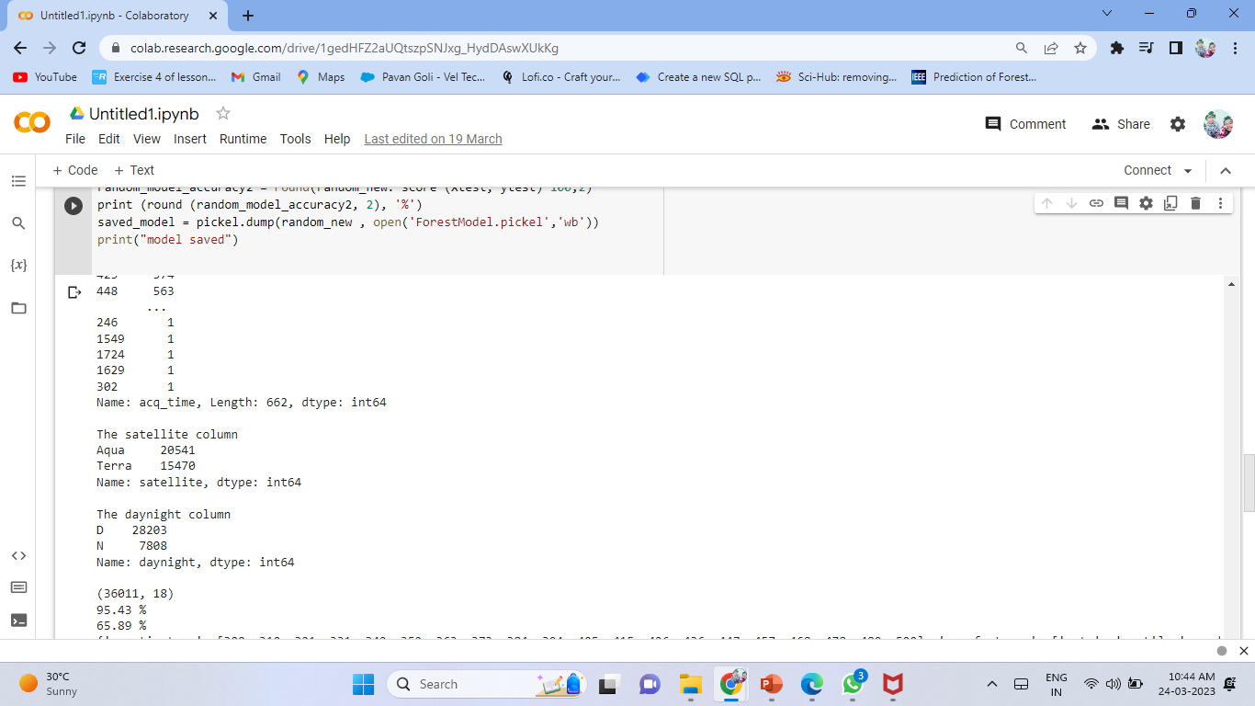
INPUT AND OUTPUT

Slide 34
CONCLUSION
Machine learning's creative and difficult approach to fire prediction. It is conceivable to employ surveillance systems to stop loss and damage brought on by random fire accidents if this system with a low mistake rate can be applied on a broad scale, such as in major companies, homes, or woods. The algorithm shows considerable potential in terms of environment adaptation. The experimental findings demonstrate that, even with an unstable measure, the suggested technique still yields high and steady outcomes . Throughout the wildlife, forest fires are a common occurrence. The globe loses millions of hectares of forest each year . Due to the priceless human lives that were lost, this also caused enormous environmental devastation. The threat of forest preservation is posed by forest fires, which also impair the ecology . Less fire damage can be achieved by quick fire detection and response. To enhance early fire prediction, several investigations are carried out. Our study was done, and we developed a system that uses user-provided meteorological information on temperature, oxygen content, and humidity to anticipate the proportions of fires that may occur. The amount of flames that might occur is properly predicted by the technique.

Slide 35
Future Enhancements
Forest fire detection is an ongoing project that may always be improved and upgraded by the addition of new features. Analyses of structure and function are giving new information on fire prediction. The new features that will be included in the future aid in not only fire prediction but also fire prevention. In the future, we may have an extra alerting mechanism that, by simply uploading a station’s weather data, might be utilised to notify a certain department. By doing this, we can aid in mitigating forest fires before they completely damage the forest. Because forest fires can be easily predicted, prevention is much simpler. We intend to enhance the accuracy and speed of our model in the future. Moreover, we would like to provide forecasts that are real-time, local, and based on satellite imagery

Slide 36
DEMO VIDEO
https://youtu.be/9nu7UiK7FYI

Slide 37
Web references/video links
https://ieeexplore.ieee.org/document/9939248
https://ieeexplore.ieee.org/document/9719887
https://ieeexplore.ieee.org/document/9672446
https://ieeexplore.ieee.org/document/8999064
https://ieeexplore.ieee.org/document/8986106
https://ieeexplore.ieee.org/document/9967973

Slide 38
REFERENCES
A. Singh and A. Singh, "Application of random forest in predicting forest fires in India," Environ. Monit. Assess., vol. 192, no. 4, pp. 1-13, 2020.
D. D. Pokhrel and D. R. Kafle, "Application of random forest algorithm in predicting the forest fire in Nepal," IOP Conf. Ser.: Earth Environ. Sci., vol. 411, no. 1, 012051, 2019.
S. S. Kumari and S. V. Rao, "Predicting forest fire using machine learning techniques," Int. J. Adv. Res. Comput. Sci. Manag. Stud., vol. 6, no. 4, pp. 39-43, 2018.
C. L. Tymstra et al., "Predicting the number of forest fires in Ontario, Canada using random forests," Int. J. Wildland Fire, vol. 24, no. 4, pp. 516-529, 2015.
M. Lim et al., "Predicting forest fire occurrences using data mining techniques: a case study in South Korea," J. Comb. Optim., vol. 36, no. 1, pp. 91-105, 2018.
G. T. McWilliams et al., "Predicting the spatial and temporal distribution of forest fires using machine learning," Ecol. Model., vol. 395, pp. 153-162, 2019

Slide 39
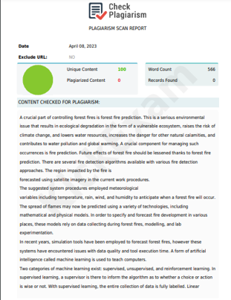
Plagiarism Report of PPT

Slide 40
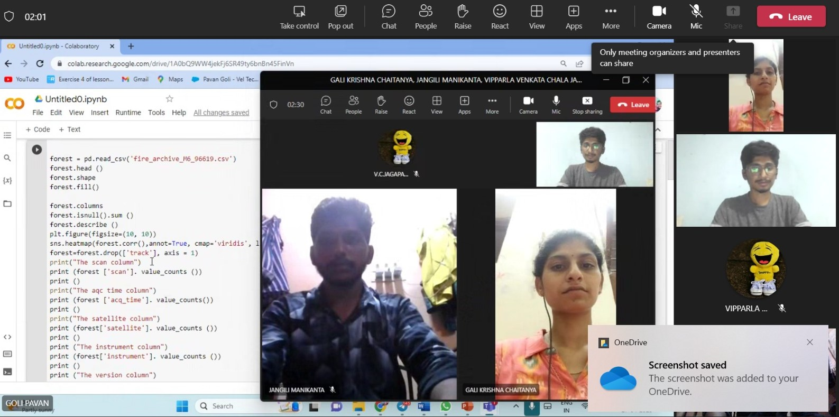
Photos in Industry

Slide 41
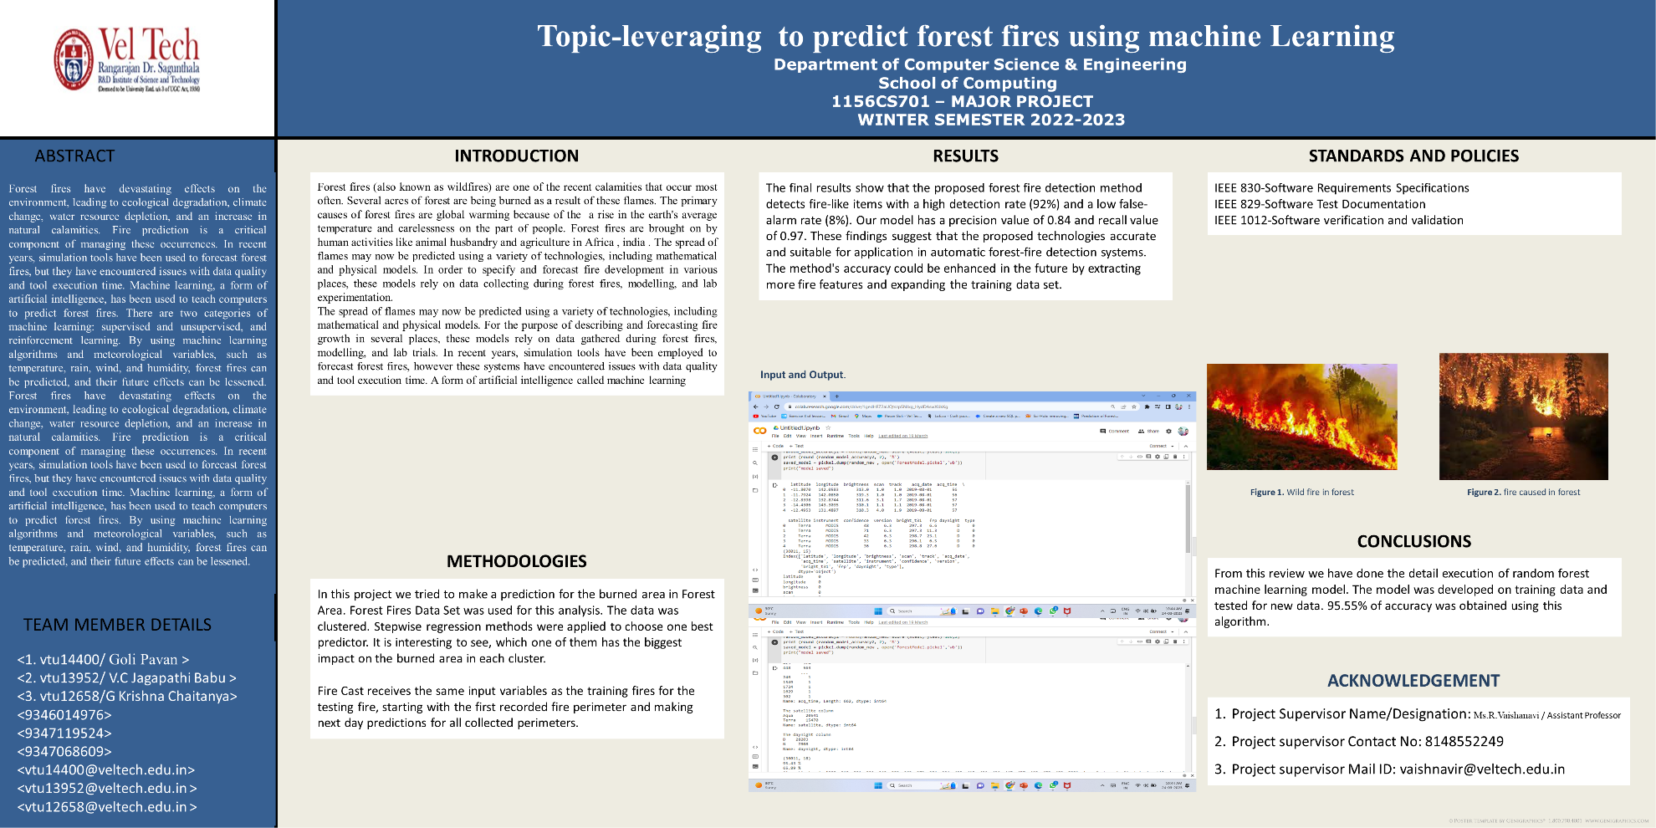
Poster Presentation

Slide 42
THANK YOU

